Slide 1
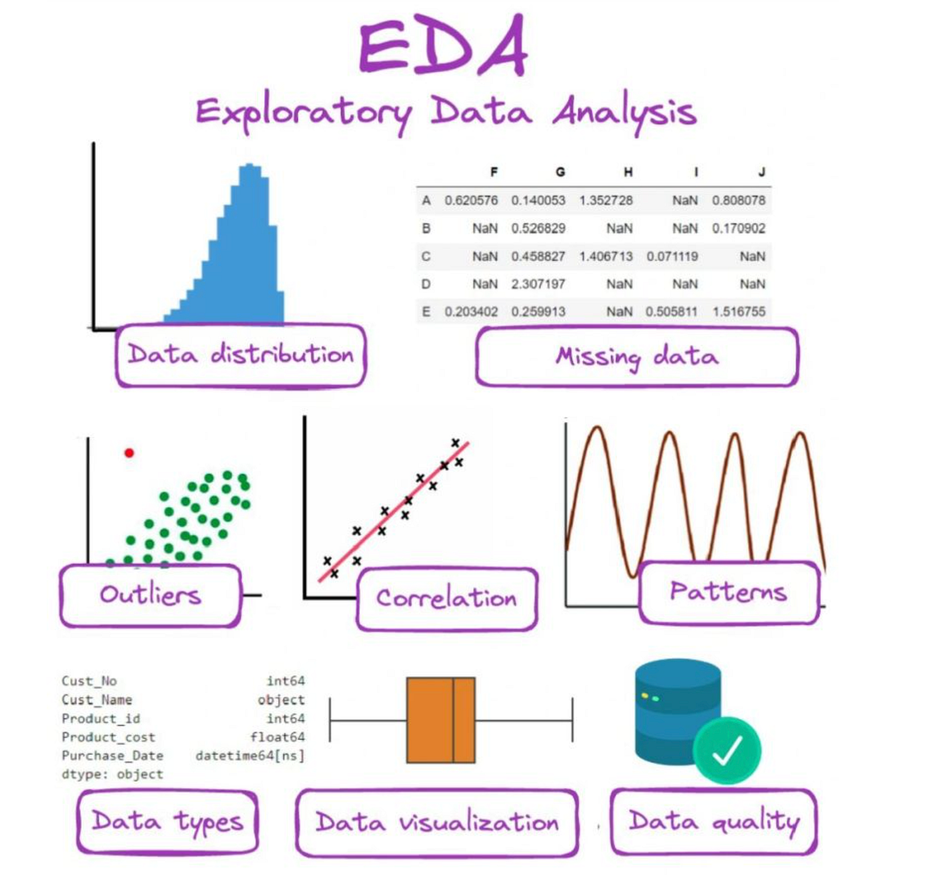
The Shape of Data (Beyond the Mean)
Moving Beyond Averages: The mean and median only tell part of the story. To truly understand data, we look at its "Physique."
Skewness: Does the data lean to the left or right? (e.g., Income data usually has a "Long Tail" to the right).
Kurtosis: Is the data "Pointy" (heavy outliers) or "Flat" (spread out)?
Why it matters: Many AI algorithms assume a perfect bell curve. If your data is too skewed, the model will fail.

Slide 2
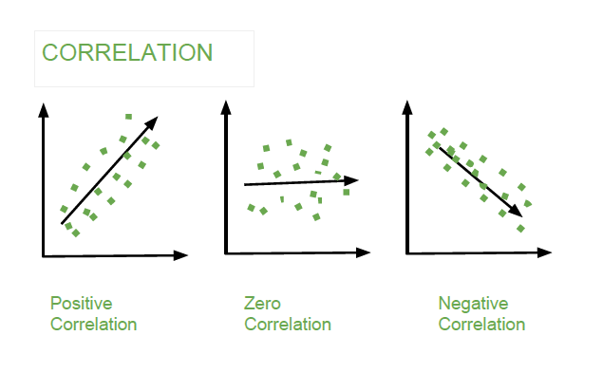
Correlation – Finding Hidden Connections
Definition: A mathematical value between -1 and 1 that shows how two variables move together.
Heatmaps: A visual grid where colors represent the strength of a relationship.
Positive vs. Negative:
Positive: As Education increases, Income tends to increase.
Negative: As Car Weight increases, Fuel Efficiency decreases.
Warning: Correlation does not equal causation!

Slide 3
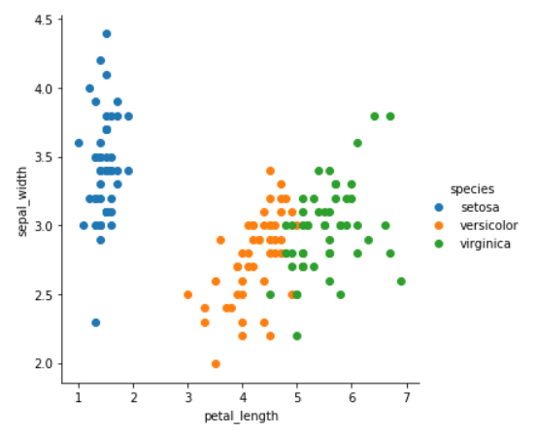
Bivariate & Multivariate Analysis
Bivariate: Comparing two variables (e.g., Rainfall vs. Crop Yield). We use Scatter Plots to see the relationship.
Multivariate: Watching 3 or more variables interact simultaneously.
The "Hue" Dimension: Adding color to a scatter plot to represent a third category (e.g., Comparing Rainfall vs. Yield, colored by "Province").
Pair Plots: A "Grand Tour" of the dataset where every variable is plotted against every other variable.

